Slide 1
Welcome to my class.
dear learners
Notes:
Welcome slide.

Slide 2
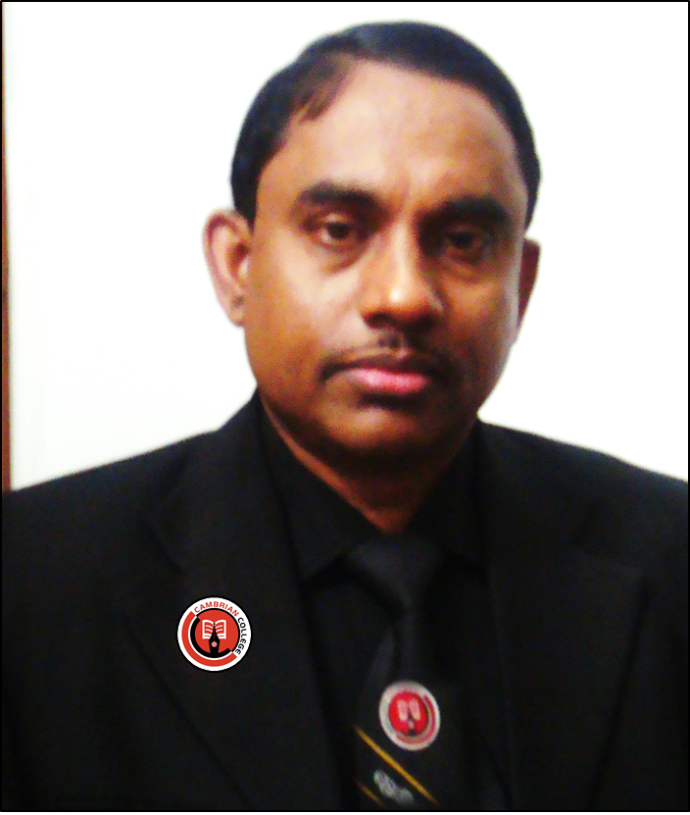
Presentation conducted by
Md. Hasan Hafizur Rahman
Lecturer & Head of the Department (English)
Cambrian School & College
Building-5, Baridhara
Dhaka
Email: hasancambrian@gmail.com
English For Today
Class-IX-X
Notes:
Identity of the teacher and the lesson

Slide 3
Watch and guess about
------ and--------.
What things are focused in the video?

Slide 4
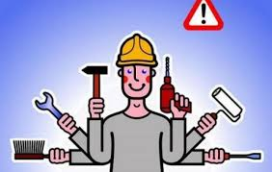
Knowledge
Skills
Notes:
Symbol of knowledge and skills.

Slide 5
Our Today’s Lesson is-
Knowledge, skills and attitudes
Unit-1, Lesson- 2

Slide 6
Learning outcomes
After completing the lesson , we will be able to—
ask and answer questions
read and understand text through silent reading
write a short paragraph
Notes:
All the four skills of English will be focused in this lesson.

Slide 7
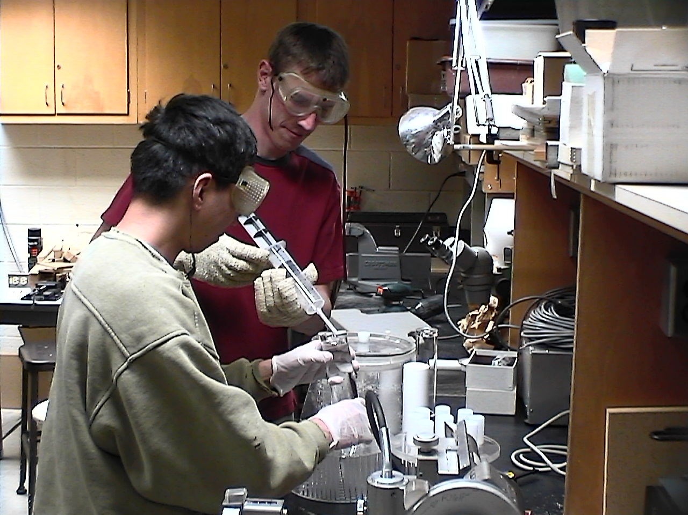
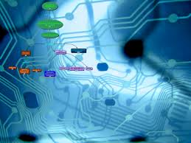
What kind of knowledge is essential to prepare yourself?
The knowledge of--
modern science, technology including ICT .

Slide 8
The other areas you, as a good citizen, you should have knowledge of---
our country,

Slide 9
its constitution,

Slide 10
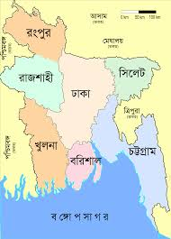
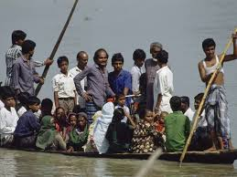
geography
and
people.

Slide 11
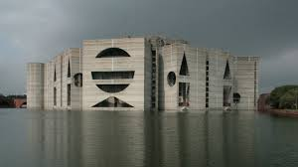
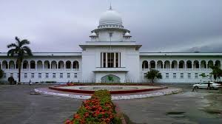
our state
our legislative power

Slide 12
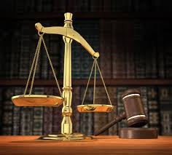
our judicial system.
Anything more?
Yes, our government, its structures and functions, our history, cultures, traditions, literature, moral values and religions, our socio-economic activities and educational system.

Slide 13
What is needed more?
It is skill & attitude.
Let’s have a look at the text book page-6 and go through “you need skills to do things----- Dhaka city corporation” including section C and D silently and loudly.
Notes:
Teacher may conduct rest this session manually by silent reading and loud reading according to his will.

Slide 14
May Allah bless you all

